Slide 1
FUTURE SIMPLE TENSE
Will Future

Slide 2
Will Future uporabljamo za dejanja v prihodnosti, ki se zgodijo brez govorčevega vpliva (weather, birthday): It will be very hot tomorrow. Angie will be 25 next Monday.
It

Slide 3
Za predvidevanja, dvome, obljube, prošnje, grožnje: I hope he will change his mind. I think I‘ll get a good mark.
I think, I suppose, I hope, I‘m sure, I‘m afraid of, I bet, I guess, I expect, I believe, I know, I doubt

Slide 4
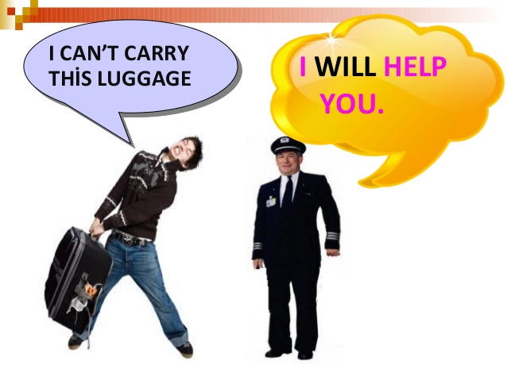
Za dejanja za katera se odločimo v trenutku in niso načrtovana: Your bag is too heavy. I‘ll carry it.

Slide 5
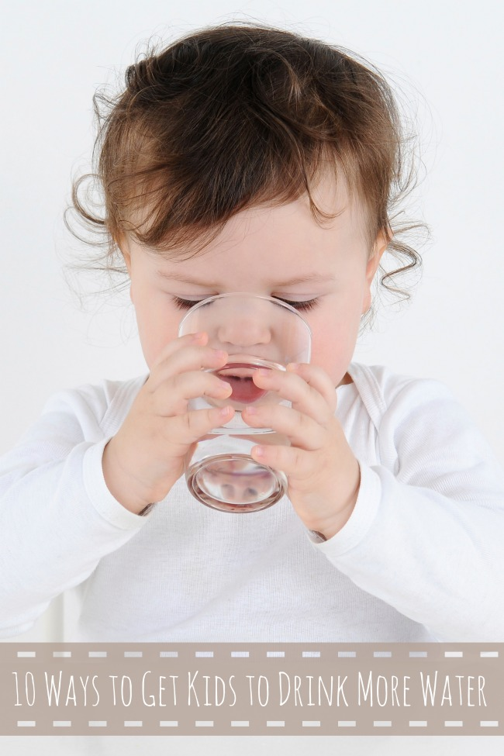
TRDILNI STAVKI:
I will get you a drink.
oseba + WILL + GLAGOL + predmet
Kratka oblika:
I‘ll get you a drink.

Slide 6
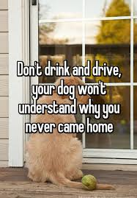
NIKALNI STAVKI:
I won‘t get you a drink.
oseba + WON‘T + GLAGOL + predmet

Slide 7
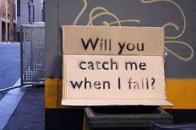
VPRAŠALNI STAVKI:
Will you get me a drink?
WILL + oseba + GLAGOL + predmet

Slide 8
Exercises Glagole v oklepaju postavi v trdilno obliko.
We …………………………..(help) you.
I ……………………………… (get) you a drink.
I think our team …………………………..(win) the match.
Maybe she ………………………………(do) a language course in Malta.
I ………………………………..(buy) the tickets.
Perhaps she ………………………………..(do) this for you.
Maybe we ……………………………………..(stay) at home.
She hopes that he …………………………………..(cook) dinner tonight.
I’m sure they ……………………………………….(understand) your problem.
They ………………………………………………………..(go / probably) to the party.

Slide 9
Glagole v oklepaju postavi v vprašalno obliko.
…………….. our team ……………….. the match? (win)
When ……………… you ……………………. in Scotland? (arrive)
………………… it ……………………….. tomorrow? (rain)
………………… you ………………………….. for a moment? (come in)
Where …………………. she ……………………….. in 2030? (live)
How old ………………. your mother …………………… in July? (be)
………………… you …………………… me the salt, please? (pass)
……………….. Rupert ………………………. breakfast? (make)
…………………… the teacher ……………………. her parents? (phone)
………………….. Frank …………………….. 16 this year? (turn)

Slide 10
Glagole v oklepaju postavi v nikalno obliko.
Tim ……………………………….. the teacher. (not tell)
I hope I ……………………………….. the train to Manchester. (not miss)
She ………………………………….. her hair green. (not dye)
He …………………………………………. breakfast tomorrow morning. (not prepare)
The manager ……………………………………. trees in front of the office building. (not plant)
Melissa …………………………………. jeans at her party. (not wear)
My friends …………………………………….. in a city. (not live)
We …………………………………….. about the bad weather. (not worry)
I ……………………………………… in this lake. (not swim)
You …………………………………………. the vase on the shelf. (not reach)

Slide 11
Glagole v oklepaju postavi v trdilno, vprašalno ali nikalno obliko.
They …………………..…….. back by 6:30 pm. (be)
…………… you …………………… me? (help)
When …………………. I ……………………… you again? (see)
His parents ……………………………………… him for being late. (not punish)
…………….. they …………………………… the contract tonight? (sign)
It ……………………………. us three hours to get there. (take)
…………………. this concert ……………………… money for our school club? (raise)
This van ………………………………… with 8 people in it. (not break down)
The meeting ……………………………………. before tomorrow morning. (not close)
When …………………. she ……………………. me a copy of her essay? (send)

Slide 12
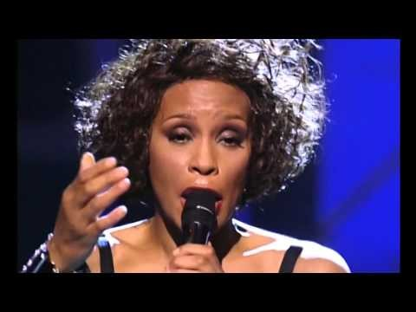
I Will Always Love You
If I should stay, I'll only be in your way So I'll go, but I know I'll Think of you every step of the way
And I will always love you I will always love you You, my darling you, hmmm,
Bittersweet memories That is all I'm taking with me So, goodbye Please, don't cry We both know I'm not what you, you need
And I will always love you I will always love you
I hope life treats you kind And I hope you have all you've dreamed of And I wish to you, joy and happiness But above all this, I wish you love
And I will always love you I will always love you I will always love you I will always love you I will always love you I, I will always love you
You, darling, I love you Oh, I'll always, I'll always love you

Slide 13
Vaje na internetu:
https://www.ego4u.com/en/cram-up/grammar/future-mix/exercises
https://www.ego4u.com/en/cram-up/grammar/future-1-will/exercises
http://www.englisch-hilfen.de/en/exercises/tenses/will_future_mix.htm
http://www.englisch-hilfen.de/en/exercises/tenses/future2.htm
http://www.englisch-hilfen.de/en/exercises/tenses/future2.htm

